Slide 1



Slide 2

BUSINESS ANALYTICS Introduction to Business Analytics and Core Business Functions
BUSINESS ANALYSIS Business Process Modeling

Slide 3

Learning Objectives – WEEK 7
By the end of today you should be able to:
Define a business process in real-world terms
Translate requirements into visual workflows
Build AS-IS and TO-BE diagrams
Understand Flowcharts vs BPMN
Use Swim-lanes to show stakeholder responsibilities

Slide 4
LAST WEEK
Last week we documented requirements:
✔ BRD ✔ SRS ✔ User Stories ✔ Acceptance Criteria
“Developers, designers, and stakeholders understand diagrams faster than long paragraphs 👉 Today we visualize those requirements.

Slide 5
WHAT IS A BUSINESS PROCESS?
A Business Process is:
A structured sequence of tasks performed by people and systems to deliver value.
🇵🇰 Pakistan Example — Daraz
Customer → Vendor → Warehouse → Rider → Delivery.
Explain:
Even though app exists, real process involves multiple departments.
🌎 International Example — Netflix Signup
User → Payment Gateway → Recommendation Engine → Account Creation.

Slide 6
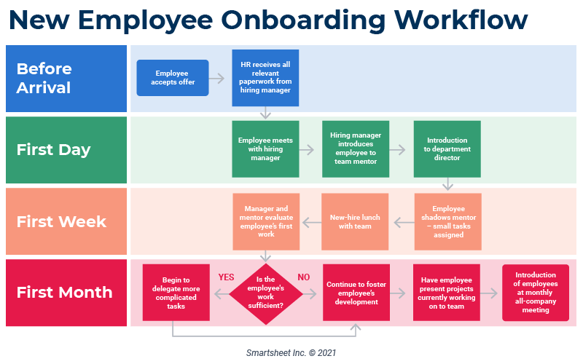
WHAT IS A BUSINESS PROCESS?

Slide 7
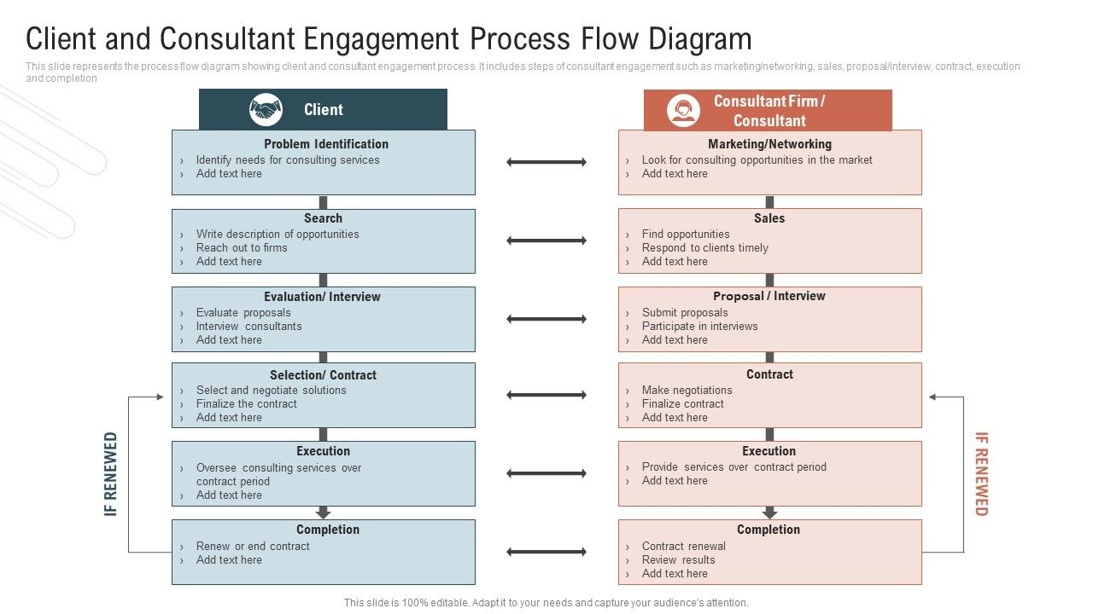
WHY PROCESS MODELING MATTERS (INDUSTRY REALITY)
Without process models:
❌ Developers misunderstand workflows ❌ Stakeholders assume different steps ❌ QA tests wrong scenarios
Real Scenario
Client says:
“Feature missing.”
BA shows process diagram → stakeholder realizes they forgot to request it.

Slide 8
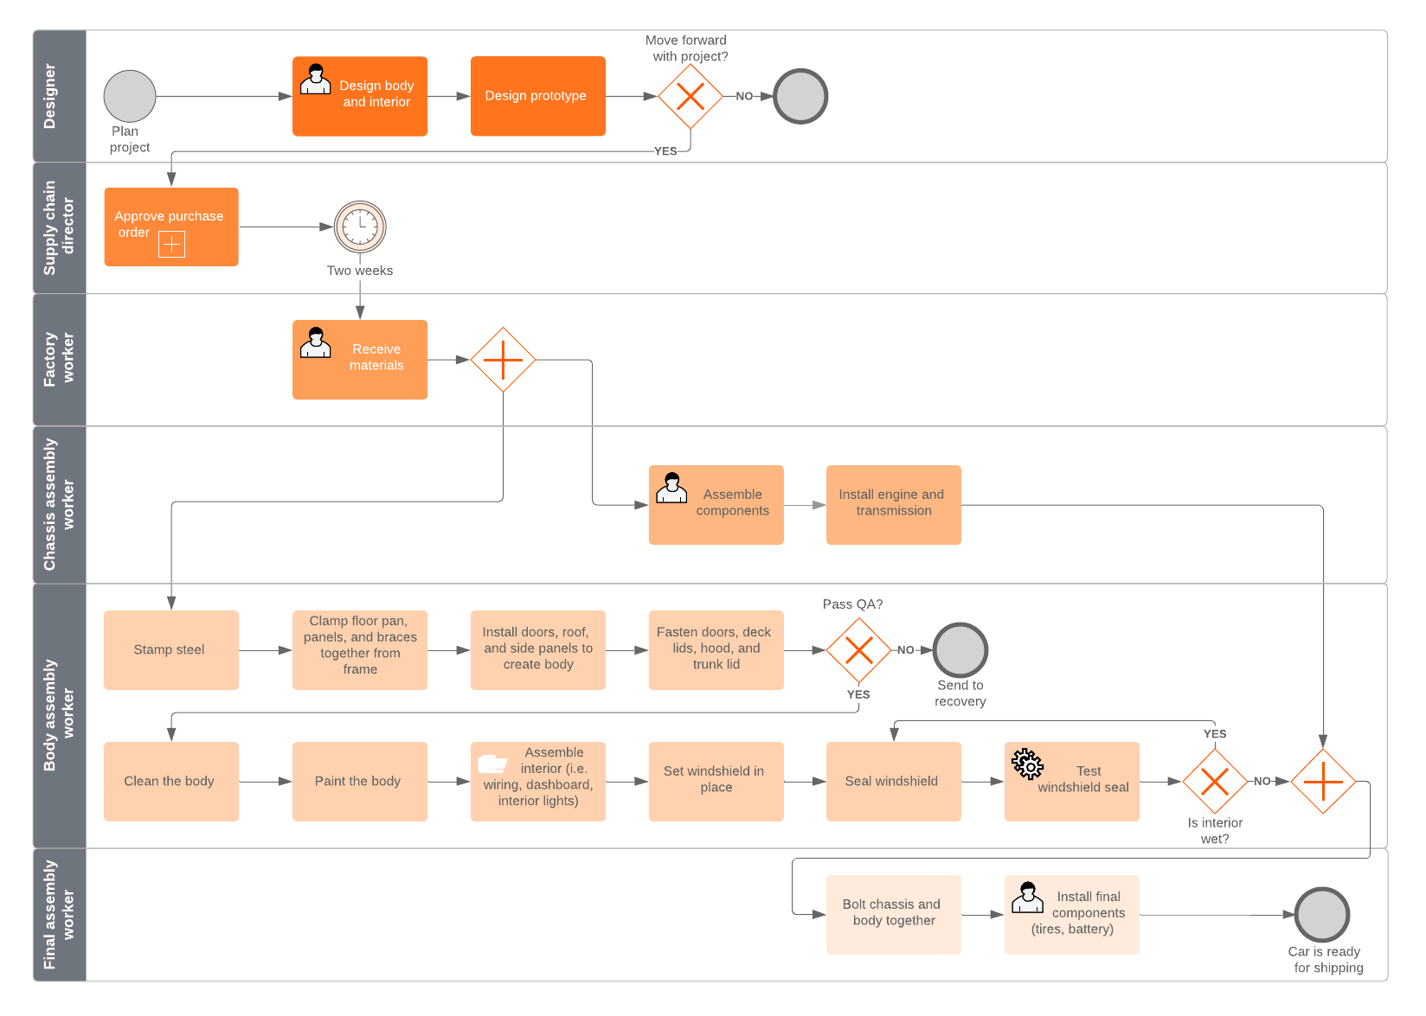
AS-IS Modeling (Current State)
AS-IS = How work happens today.
Purpose:
Identify inefficiencies, delays, manual tasks
🇵🇰 QuickBasket Example
Customer WhatsApp → Operations assign rider manually → Delivery
Problems:
Delays
Human error
No tracking

Slide 9
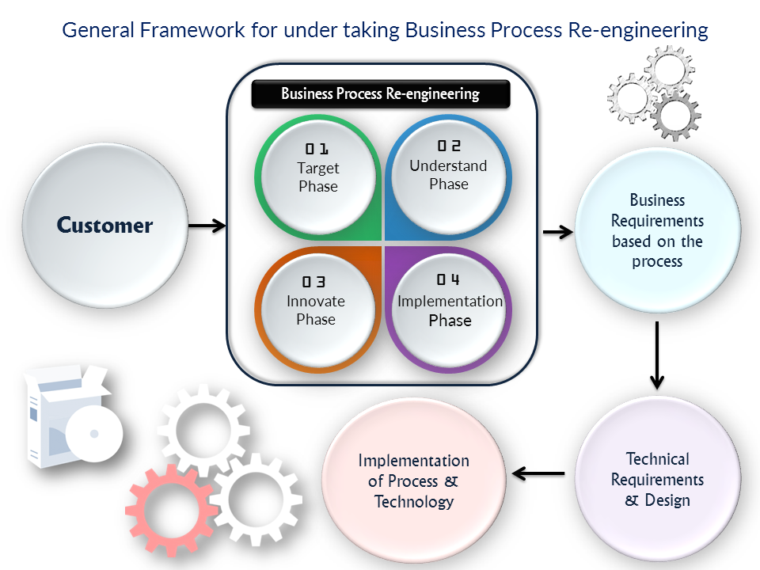
TO-BE MODELING (FUTURE STATE)
TO-BE = Optimized process after improvement
Example:
Customer App → Auto Payment → Auto Rider Assignment → Live Tracking
Teaching insight: AS-IS shows pain. TO-BE shows solution.
This prepares students for Week 8 (Process Improvement).
“This concept becomes critical when we discuss process improvement next week”

Slide 10
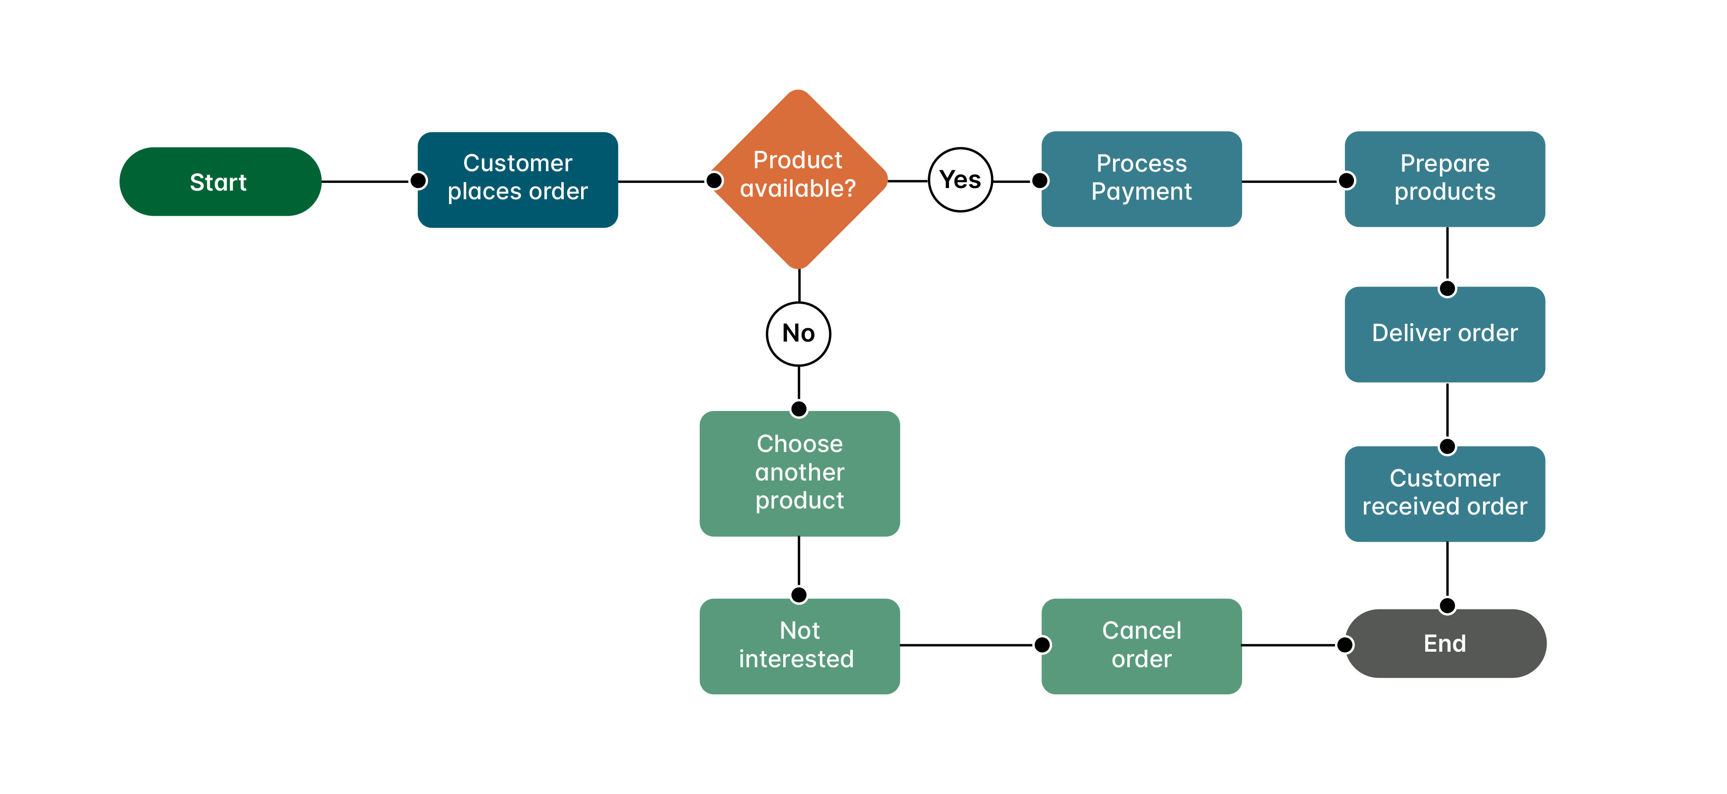
FLOWCHARTS
Flowcharts are the simplest way to represent processes
Shape | Meaning | Teaching Tip
Oval | Start/End | Always begin & finish
Rectangle | Task | Action happens
Diamond | Decision | Yes/No branch
Arrow | Flow | Direction
🇵🇰 Example — Careem Ride Flow
Start → Enter Location → Driver Available? → Confirm Ride → End.
Common Beginner Mistake
Students create linear flows without decisions.
Real processes always include decisions

Slide 11
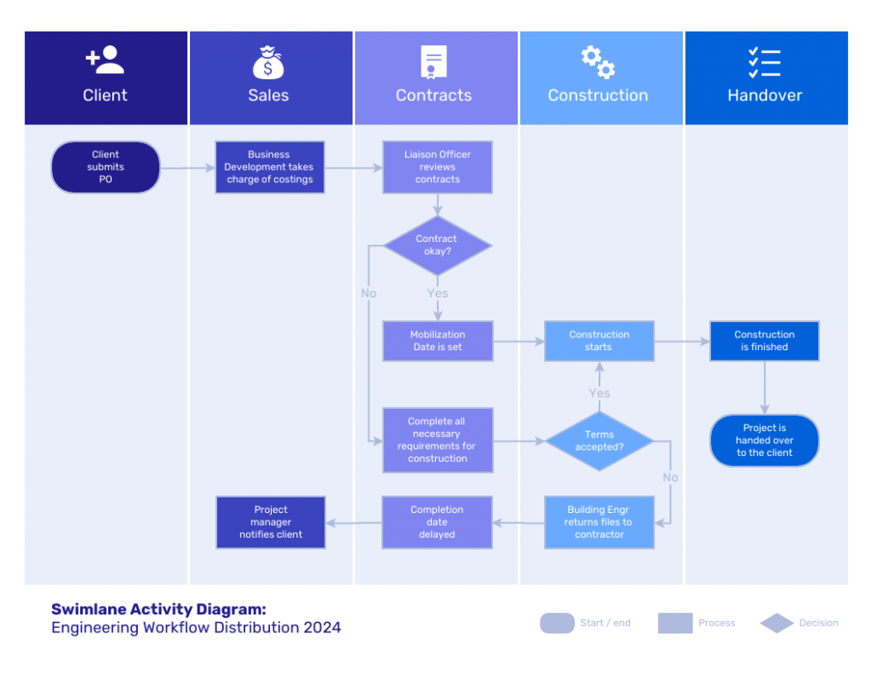
SWIMLANE DIAGRAMS
Explain:
Swimlanes divide process by roles.
Example lanes:
Customer | System | Operations | Rider.
Visual Example
Customer: Place Order System: Validate Payment Operations: Assign Rider Rider: Deliver
Swimlanes reveal responsibility.

Slide 12
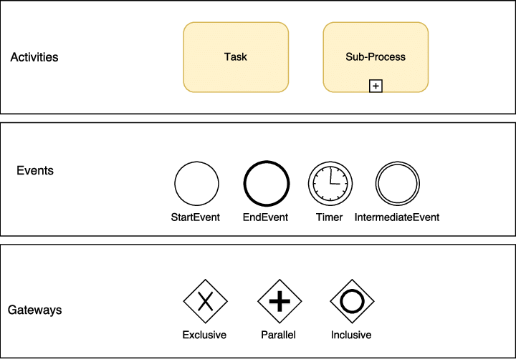
BPMN (INDUSTRY-LEVEL MODELING)
Flowcharts = Simple BPMN = Professional version of flowcharts used in industry
Basic BPMN Elements
Element | Meaning
Start Event | Process begins
Task | Action step
Gateway | Decision point
End Event | Completion
🌎 International Example
Bank loan approval BPMN:
Customer submits request → Risk assessment → Approval decision → Payment.
BPMN stands for Business Process Model and Notation

Slide 13
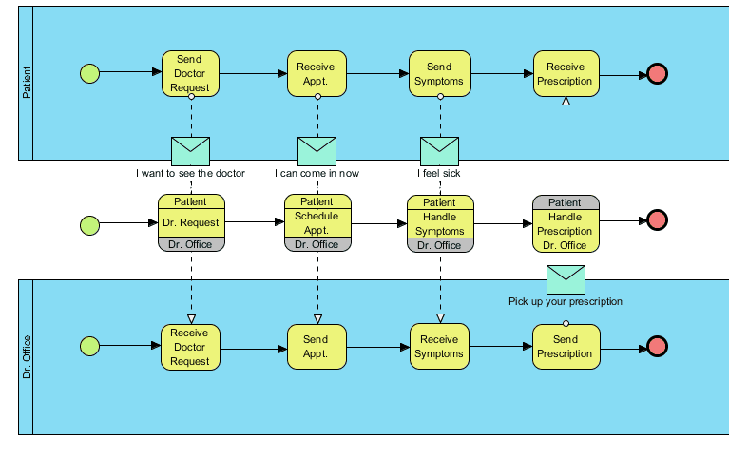

Slide 14
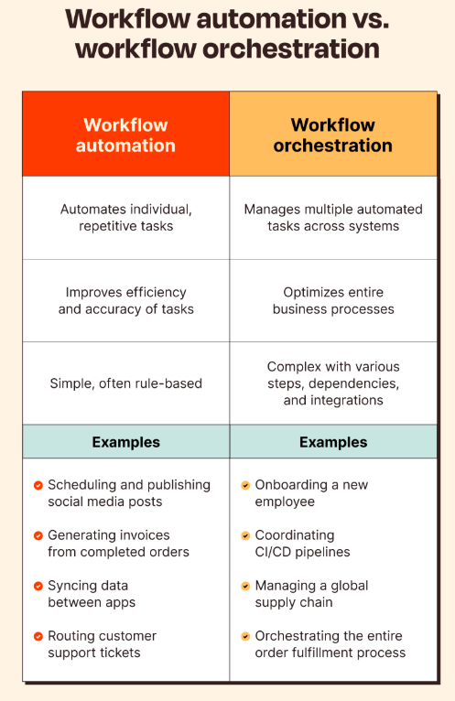
PROCESS MODELING MISTAKES (VERY IMPORTANT)
❌ Too much detail (technical logic) ❌ Missing stakeholders ❌ No clear start/end ❌ Confusing system vs human actions

Slide 15
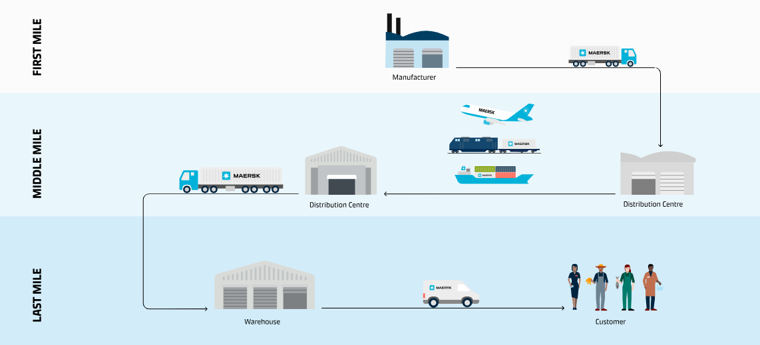
LIVE CASE STUDY
Scenario:
QuickBasket grocery delivery.
Groups must create:
✔ AS-IS Flowchart ✔ TO-BE Swimlane Diagram
Let groups present.
Challenges:
“Where is bottleneck?”
Cases to handle “Where is delay occurring?”
“Which stakeholder performs this task?”

Slide 16
ADVANCED INSIGHT
Explain difference:
Process Modeling vs User Journey.
Process Model | User Journey
Internal workflow | Customer experience
Multiple roles | Single perspective
Example:
Daraz order process vs customer shopping journey.

Slide 17
KEY TAKEAWAYS
Business Analysts turn complexity into clarity.
Summary:
Processes show how work happens.
AS-IS identifies problems.
TO-BE proposes improvements.
Flowcharts simplify understanding.
BPMN supports professional modeling.
Swimlanes show responsibilities.

Slide 18
“Most process improvements start when someone finally maps the process visually.”
“Many problems are invisible until we draw the workflow.”
“Good diagrams save hours of meetings.”

